Slide 1
CS661 PROJECT
Group - 7
Visual Analytics System based on Google Trends Visualization

Slide 2
Group - 7
Bachhav Aryan Kishor - 210253
Arpit Anand - 218070190
Rubal Gajbhiye - 241280002
Mritunjay Maddhesiya - 210636
Prince Kumar - 210768
J Kartik Sai - 241280001
Anuj Chaudhary - 210167

Slide 3
Introduction and Aim
Objective: Create an interactive dashboard for visualizing Google Trends data based on
Geography
Search Categories
Keyword Interest Over Time
Key Data Features and attributes to drill down on:
Normalized search interest scores (0 to 100)
Relative (not absolute) popularity
Global coverage with regional filtering (country, region)

Slide 4
About the dataset
Search Term: The exact word or phrase entered by users into the search engine, capturing the specific focus of public curiosity or interest.
Category: A broader topic area to which the search term belongs. Some examples include:
Business — corporate news, markets, finance.
Health — wellness trends, diseases, healthcare information.
Science and Technology — gadgets, software, innovations in science
Geography: Country-level data showing where the search term was most popular, enabling geographic analysis of interests.
Year: The year during which the search activity was recorded, allowing time-based trend analysis.

Slide 5
About the dataset
Interest Score:
A normalized value from 0 to 100 for each search term.
100 represents the highest recorded popularity for a search term.
Values are relative — not the total number of searches, but how popular a term is compared to its peak.
Purpose and Utility:
Facilitates comparisons across countries, categories, and years.
Helps uncover:
Seasonal search patterns (e.g., flu searches peaking in winter).
Regional preferences (e.g., tech searches in the USA vs education in India).
Emerging global topics based on changing search behavior.

Slide 6
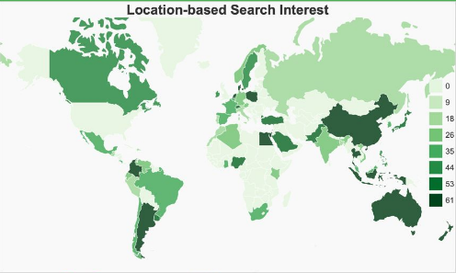
Plots - World Choropleth map
Purpose:
Highlights the top search categories geographically across countries.
Insights Provided:
Shows regional variations in search interests.
Identifies countries with dominant interest in specific categories.

Slide 7
Plots - World Choropleth map
Observations:
China, Australia, Canada and Argentina show a high volume of internet activity along with few others
Insights Provided:
High internet penetration and diverse search behavior reflect economic and societal dynamics.

Slide 8
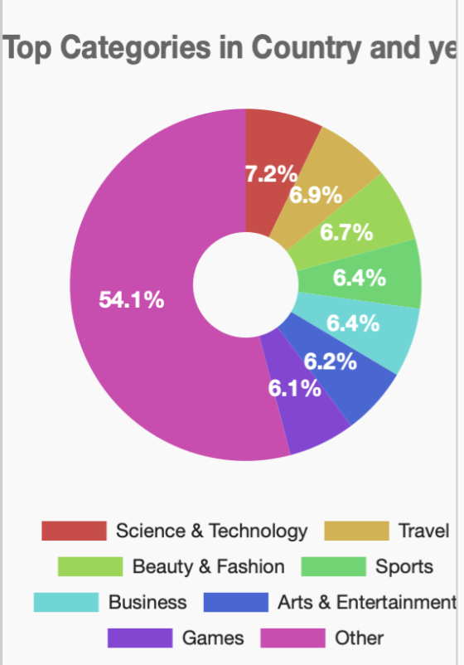
Plots - Pie Chart
Purpose:
Displays the distribution of top search queries by category and year.
Helps identify which categories dominate global user interest for a selected country and year.
Insights Provided:
Proportions of different search categories.
Immediate visibility into globally trending areas of public focus.

Slide 9
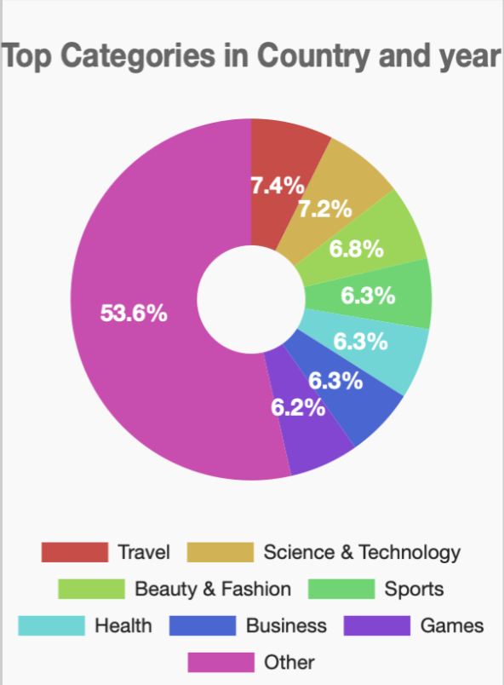
Plots - Pie Chart
Observations:
Science and technology has the highest share (ignoring the OTHERS category).
Real estate is the least popular and Sport, business and Arts & entertainment being the average or mode-like popularity.
Insights Provided:
These categories help understand the current state of internet search behaviour trends and show the relevance on a global stage

Slide 10
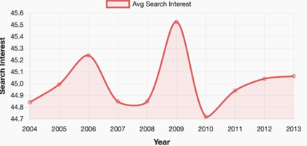
Plots - Line graph
Purpose:
Plots the evolution of search interest over time for selected queries or categories.
Insights Provided:
Trends over multiple years — rising or falling interest patterns.
Identification of seasonal spikes, sustained interest, or declining topics.

Slide 11
Plots - Line graph
Purpose:
There is a peak in internet search trend activity during 2009 following a dip in 2010 and a gradual increment later on
Insights Provided:
Indicates changes and other dynamics of search activities of different topics in a temporal manner

Slide 12
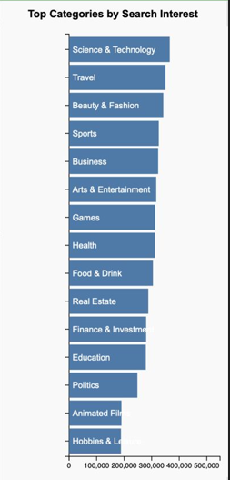
Plots - Bar Graph
Purpose:
Compares search interest for specific country.Over the years.
Insights Provided:
Showcases the different search in interest for different categories
How search trends evolve differently across countries.

Slide 13
Plots - Bar Graph
Observation:
The Science and Technology and Travel are Top 2 categories on a global level.
Insights Provided:
Priorities and cultural factors strongly influence search behavior.

Slide 14
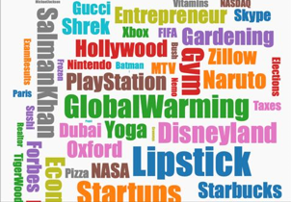
Plots - Word Cloud
Purpose:
Visual representation of the most frequently searched query for a specific year.
Insights Provided:
More number of query = Higher popularity
Quick snapshot of trending keywords without needing to read through data tables.

Slide 15
Plots - Word Cloud
Observation:
Lipstick is the biggest search trend followed by Gym and few other specific keywords.
Keywords like "Lipstick" and "Global Warming" dominate specific years.
Insights Provided:
Word Clouds quickly highlight the most impactful global events or trends each year.

Slide 16
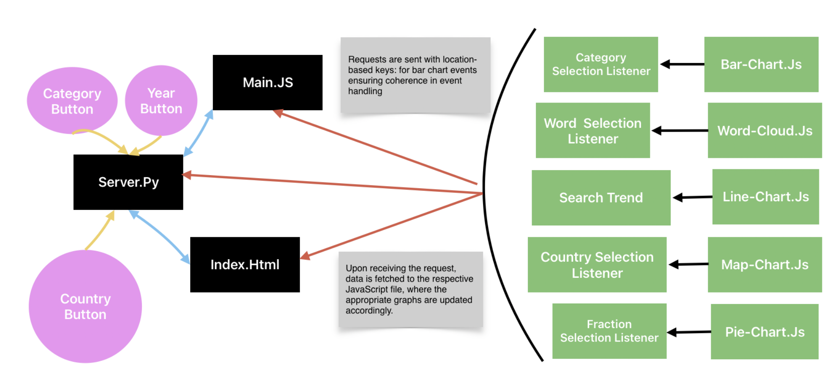
Architecture and execution

Slide 17
Architecture and execution
Data Flow:
User Input: Selects filters (Year, Country, Category) on the dashboard.
Backend (Flask): Reads relevant CSV files, applies filters.
JSON Response: Sends processed data (for Pie, Map, Line, Bar, and Word Cloud plots) to frontend. Frontend (D3.js): Dynamically updates the visualizations based on new data.
System Highlights:
Real-time, interactive data filtering.
Modular design — easy to add new visualizations or datasets.
Lightweight and scalable for future enhancements like live data integration.

Slide 18
Results
Key Observations:
Global Dominance: Business, Health, and Politics categories consistently lead global searches.
Regional Trends:
USA and India show high interest in Business and Technology.
China and India among the top internet users globally.
Category Distribution: Pie charts show balanced interest across Business, Health, Education, and Politics.
Seasonal Patterns: Certain categories show recurring seasonal spikes in search interest.

Slide 19
Conclusion and link to GitHub
Summary:
Successfully built an interactive dashboard to explore global search trends.
Visualizations helped uncover meaningful patterns across geography, time, and categories
Future Scope:
Integrate live data updates.
Add more granular filters (e.g., city-level analysis).
Explore predictive trends using historical data.
Link to GitHub

Slide 20
Thank you

